Slide 1

Review
Using Files for Data Storage

Slide 2
Using Files for Data Storage
Can use files instead of keyboard, monitor screen for program input, output
Allows data to be retained between program runs
Steps:
  Open the file
  Use the file (read from, write to, or both)
  Close the file

Slide 3
Files: What is Needed
Use fstream header file for file access
File stream types:
  ifstream for input from a file
  ofstream for output to a file
  fstream for input from or output to a file
Define file stream objects:
  ifstream infile;
  ofstream outfile;

Slide 4
Opening Files
Create a link between file name (outside the program) and file stream object (inside the program)
Use the open member function:
  infile.open("inventory.dat");
  outfile.open("report.txt");
Filename may include drive, path info.
Output file will be created if necessary; existing file will be erased first
Input file must exist for open to work

Slide 5
Testing for File Open Errors
Can test a file stream object to detect if an open operation failed:
  infile.open("test.txt");
  if (!infile)
  {
  cout << "File open failure!";
  }
Can also use the fail member function

Slide 6
Using Files
Can use output file object and << to send data to a file:
  outfile << "Inventory report";
Can use input file object and >> to copy data from file to variables:
  infile >> partNum;
  infile >> qtyInStock >> qtyOnOrder;

Slide 7
Using Loops to Process Files
The stream extraction operator >> returns true when a value was successfully read, false otherwise
Can be tested in a while loop to continue execution as long as values are read from the file:
  while (inputFile >> number) ...

Slide 8
Closing Files
Use the close member function:
  infile.close();
  outfile.close();
Don’t wait for operating system to close files at program end:
  may be limit on number of open files
  may be buffered output data waiting to send to file

Slide 9
Letting the User Specify a Filename
The open member function requires that you pass the name of the file as a null-terminated string, which is also known as a C-string.
String literals are stored in memory as null-terminated C-strings, but string objects are not.

Slide 10
Letting the User Specify a Filename
string objects have a member function named c_str
  It returns the contents of the object formatted as a null-terminated C-string.
  Here is the general format of how you call the c_str function:
stringObject.c_str()

Slide 11
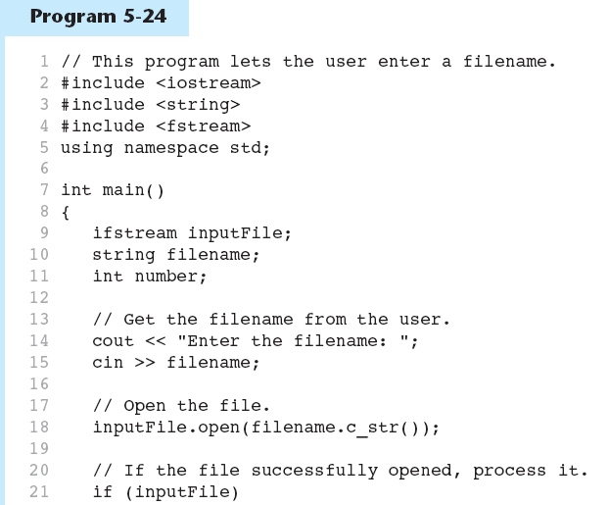
Letting the User Specify a Filename in Prog. 5-24
Continued…

Slide 12
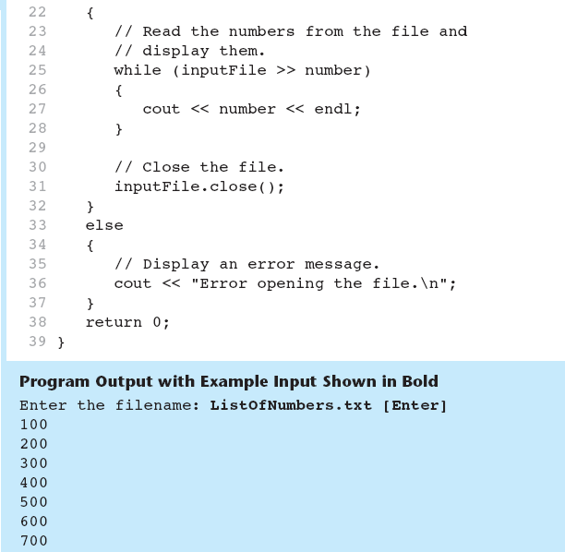
Letting the User Specify a Filename in Prog 5-24

